Slide 1
AI-Based Sleep Stage Classification A Deep Learning Pipeline Using Single-Channel EKG

Slide 2
Group members
01
02
03
Hassan hashim
Abdelrahman essam
Basil hassan

Slide 3
Project Idea
01
02
Goal: Build an AI model that classifies sleep stages using physiological signals
The AI model will learn patterns in sleep signals to identify sleep stages automatically.

Slide 4
Project Overview
What is this?
Why it matters
▸ Automatically classify 5 sleep stages from a single ECG (EKG) channel
▸ Manual sleep scoring is expensive & time-consuming
▸ Uses 30-second epochs from overnight sleep recordings
▸ Autonomic nervous system signatures differ across stages
▸ Stages: Wake, N1, N2, N3 (Deep Sleep), REM
▸ Enables large-scale, affordable sleep health monitoring
▸ Trained on the MESA polysomnography dataset
▸ Cohen's Kappa validates agreement with expert annotations
▸ End-to-end pipeline: raw EDF files → trained model → evaluation

Slide 5
Project Overview
The Problem
Why ECG Only?
Sleep disorders affect billions worldwide. Traditional PSG (polysomnography) requires full EEG + EOG + EMG setups in clinical labs — expensive, uncomfortable, and inaccessible.
Goal: Can a SINGLE ECG channel classify sleep stages accurately using deep learning?
✓ Wearable-friendly
✓ Non-invasive & cheap
✓ Captures ANS rhythms
✓ Home monitoring ready

Slide 6
Data Pipeline
From raw EDF recordings to clean, labeled training tensors
1
2
3
4
5
Load EDF
Resample
& Filter
Parse XML
Annotations
Epoch
Slicing
Normalize
MNE reads raw signals recordings
Exact 'EKG' channel selected
Downsample to 100 Hz
0.5–40 Hz bandpass (Butterworth)
Sleep stage labels extracted
Mapped to 5 classes (0–4)
Cut into 30s windows
= 3,000 samples per epoch
Z-score per epoch
mean subtracted, std divided
Output shape per subject: X = (n_epochs, 1, 3000) y = (n_epochs,)

Slide 7
Sleep Stage Annotation & Label Parsing (Cell 4)
0 — Wake
1 — N1
2 — N2
3 — N3
4 — REM
Stage 0
Stage 1
Stage 2
Stage 3/4
REM
Full consciousness, eyes open/closed.
Light sleep onset.
Established sleep.
Deep/slow wave sleep.
Rapid Eye Movement..

Slide 8
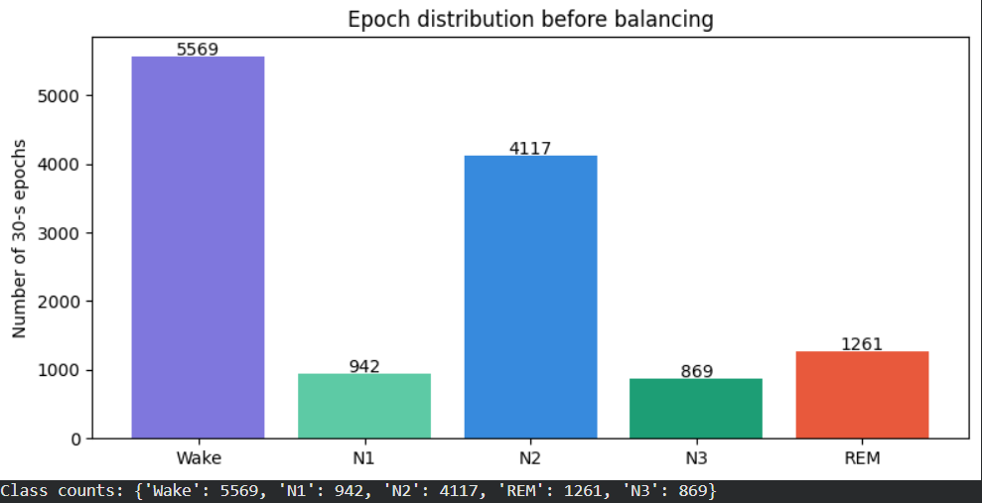
Class Imbalance & Augmentation Strategy
How We Fix the Imbalance
Gaussian Noise
Add small random noise (σ=0.05)
Amplitude Scale
Random ×0.8–1.2 scaling — simulates sensor variability
Baseline Wander
Sinusoidal drift (0.05–0.3 Hz) added to signal
Time Shift
Circular roll ±150 samples — positional invariance
Mixup (N1 only)
Blend two N1 epochs
Target: N1, N3, REM oversampled to 70% of majority class count

Slide 9
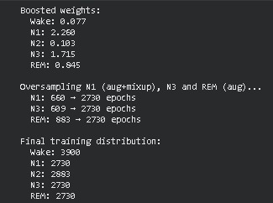
Class Imbalance & Augmentation Strategy
How We Fix the Imbalance
Gaussian Noise
Add small random noise (σ=0.05)
Amplitude Scale
Random ×0.8–1.2 scaling — simulates sensor variability
Baseline Wander
Sinusoidal drift (0.05–0.3 Hz) added to signal
Time Shift
Circular roll ±150 samples — positional invariance
Mixup (N1 only)
Blend two N1 epochs
Target: N1, N3, REM oversampled to 70% of majority class count

Slide 10
Loss Function & Class Weights (Cell 9)
Focal Loss
Combined Loss Formula
Formula:
L = −(1 − pt)^γ · log(pt)
pt = probability of correct class (from softmax) γ = 2.5 — focusing parameter (raised from 2.0) Effect: Easy examples (high pt) → low weight; hard misclassified examples → high weight Why: N1 and REM are hard to classify → focal loss focuses training on them
Loss = 0.7 × Focal + 0.3 × CrossEntropy(label_smooth=0.1)
Label smoothing (0.1) prevents overconfidence on training data

Slide 11
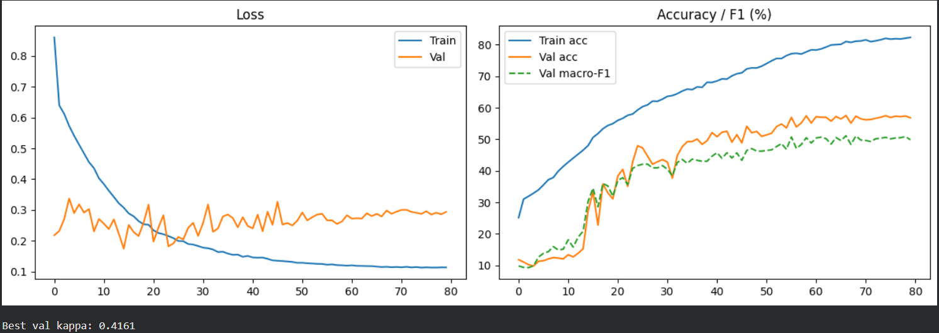
Loss Function & Class Weights (Cell 9)
Focal Loss
Combined Loss Formula
Formula:
Loss = 0.7 × Focal + 0.3 × CrossEntropy(label_smooth=0.1)
L = −(1 − pt)^γ · log(pt)
Label smoothing (0.1) prevents overconfidence on training data
pt = probability of correct class (from softmax) γ = 2.5 — focusing parameter (raised from 2.0) Effect: Easy examples (high pt) → low weight; hard misclassified examples → high weight Why: N1 and REM are hard to classify → focal loss focuses training on them
Boosted Class Weights
Wake
N1
N2
N3
REM
×1.0
×5.0
×1.0
×3.5
×2.5
N1 boost raised 3.0→5.0 as it remained the weakest class in validation
On-the-fly Noise Augmentation During Training
20% of training batches receive additional Gaussian noise (σ=0.02) added to the input tensor in GPU memory. This differs from the pre-computed augmentation — it adds variability at training time, not preprocessing time. Combined effect: model sees pre-augmented data PLUS runtime noise → more diverse training signal per epoch.

Slide 12
Spectral Feature Extraction (Cell 10)
Why frequency-domain features? The Autonomic Nervous System (ANS) modulates heart rate differently across sleep stages — captured via HRV spectral bands, not raw ECG power.
5 Frequency Bands Extracted per Epoch (via STFT)
LF-HRV
Sympathetic activity. Elevated during Wake & REM (stress response). Suppressed in N3.
0.04–0.15 Hz
HF-HRV
Parasympathetic / Respiratory Sinus Arrhythmia. Peaks in N3 (deep sleep). Low in Wake/REM.
0.15–0.40 Hz
Delta-ECG
ECG envelope in delta frequency range. Changes with cardiac cycle morphology across stages.
0.5–4.0 Hz
QRS-Band
Main QRS complex energy. Reflects heart rate and conduction. Useful for HR-based classification.
4.0–15.0 Hz
HF-ECG
High-frequency ECG content. Muscle artefact marker. Helps detect noisy or wake-state epochs.
15–40 Hz
Result: Each epoch goes from (1, 3000) → (6, 3000) = 1 raw ECG channel + 5 spectral band channels | Memory-safe: processed in batches via memmap

Slide 13
Model Architecture
SequenceSleepModel — processes 9 consecutive epochs for temporal context
Input
Sequence
EpochEncoder
× 9
Positional
Embedding
Sequence
Transformer
Classifier
Head
Output
Stage
(B, 9, 6, 3000)
CNN + Transformer
per epoch
9 positions
d_model=256
2 layers
8 heads
256→128→5
Dropout 0.55/0.45
Wake/N1/N2
N3/REM
Attention
Pooling

Slide 14
Training Strategy & Hyperparameters (Cells 13–14)
Optimizer: AdamW
Training Loop — Per Epoch
Learning Rate:
8e-5 (lowered from 1e-4 to reduce overfit)
1. Train: forward pass → focal+CE loss → backprop
Weight Decay:
1e-2 (L2 penalty, raised from 5e-3)
2. Optional noise injection (20% of batches)
Betas:
(0.9, 0.999) — standard momentum
3. Gradient clipping (norm ≤ 1.0)
Gradient Clip:
max_norm=1.0 — prevents exploding gradients
4. Validate: collect preds, compute kappa & F1
Warmup Cosine Scheduler
5. Scheduler step → update LR
6. If val_kappa > best → save checkpoint
Warmup:
8 epochs (linear ramp-up)
7. Patience counter: if no improvement for 20 epochs → early stop
Decay:
Cosine annealing after warmup
8. Monitor: train acc, val acc, macro-F1, Cohen's κ
eta_min:
1e-6 (minimum learning rate)
Total:
80 epochs maximum
9. Plot loss curves and accuracy after training

Slide 15
Evaluation & Metrics
✓
Accuracy
κ
Cohen's Kappa
F1
Macro F1-Score
Overall % of epochs correctly classified
across all 5 sleep stages
Agreement beyond chance.
κ > 0.6 = substantial, κ > 0.8 = near-perfect
Unweighted average F1 across all classes.
Penalizes models that ignore rare stages
Confusion Matrix
Visual Outputs
▸ Normalized by true class (rows sum to 1.0)
ROC Curves
One-vs-Rest AUC for all 5 stages
on Train / Val / Test splits
▸ Reveals per-class errors: e.g., N1↔N2 confusion
Hypnogram
▸ Displayed with 'Blues' colormap in Matplotlib
Side-by-side true vs predicted
sleep stage timeline over the night
Training Curves
▸ Shows whether model correctly distinguishes N3 and REM
Loss and accuracy vs epoch
with macro F1 overlay

Slide 16
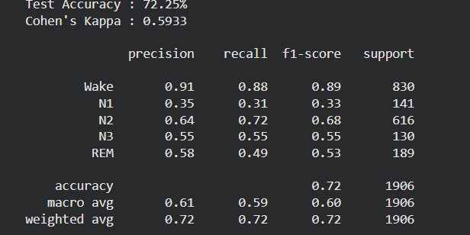
Evaluation Metrics & Results (Cell 15)
Overall
Accuracy
Cohen's
Kappa
Macro
F1-Score
AUC-ROC
One-vs-Rest
0.72
Κ=0.5933
0.61
~0.90+
% correctly classified epochs across all 5 stages
Agreement beyond chance — primary checkpoint metric
Mean F1 across all 5 classes — equal class weight
Discriminability per class (train / val / test shown)
Per-Class Performance — Classification Report

Slide 17
Evaluation Metrics & Results (Cell 15)
Overall
Accuracy
Cohen's
Kappa
Macro
F1-Score
AUC-ROC
One-vs-Rest
0.72
Κ=0.5933
0.61
~0.90+
% correctly classified epochs across all 5 stages
Agreement beyond chance — primary checkpoint metric
Mean F1 across all 5 classes — equal class weight
Discriminability per class (train / val / test shown)
Per-Class Performance — Classification Report
Stage
Precision
Recall
F1-Score
Challenge
Wake (0)
High
High
High
Easy — physiologically distinct
N1 (1)
Low→Med
Low→Med
Lowest
Hardest: transitions, little ECG signature
N2 (2)
High
High
High
Most epochs available, well-learned
N3 (3)
Med→High
Med→High
Good
Distinct slow HR — benefits from HF-HRV band
REM (4)
Med
Med
Medium
HR similar to Wake — needs contextual epochs

Slide 18
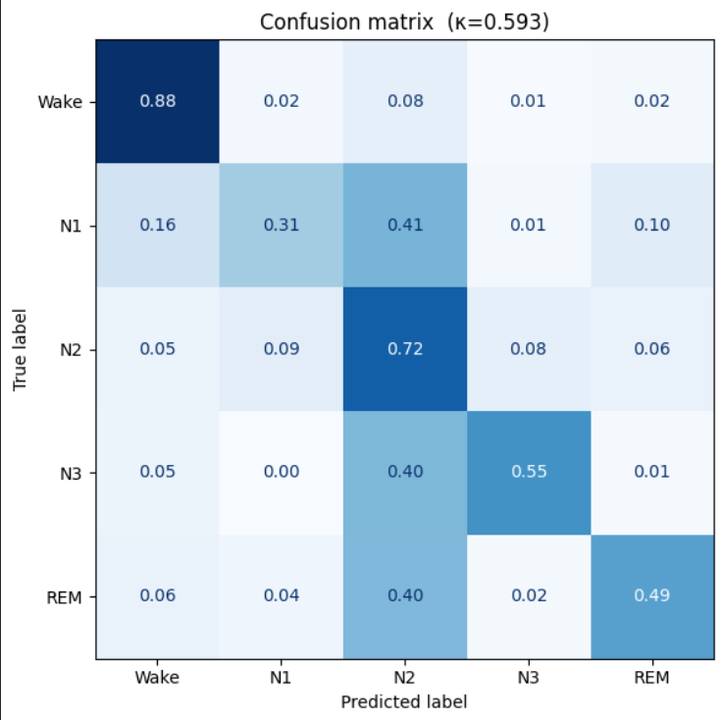
Confusion Matrix & Hypnogram Interpretation
Confusion Matrix (Normalized by True Label)
Key Observations
Pred→
Wake
N1
N2
N3
REM
Wake
↓True
0.82
0.03
0.08
0.00
0.07
N2 & N3 — highest accuracy
Most distinct ECG patterns; large training set for N2
N1
0.12
0.45
0.30
0.03
0.10
N1 — most confused class
N2
0.04
0.06
0.84
0.04
0.02
Confused with Wake (12%) and N2 (30%) — transition stage
REM ↔ Wake confusion
N3
0.01
0.03
0.12
0.82
0.02
Both show irregular HR & low HF-HRV
REM
0.10
0.06
0.08
0.01
0.75
N3 rarely misclassified
Parasympathetic dominance creates clear ECG pattern — benefits from HF-HRV band feature
Hypnogram: Side-by-side True vs Predicted sleep stages plotted over time (hours) — shows the model captures the overall sleep architecture despite some N1/REM confusion

Slide 19
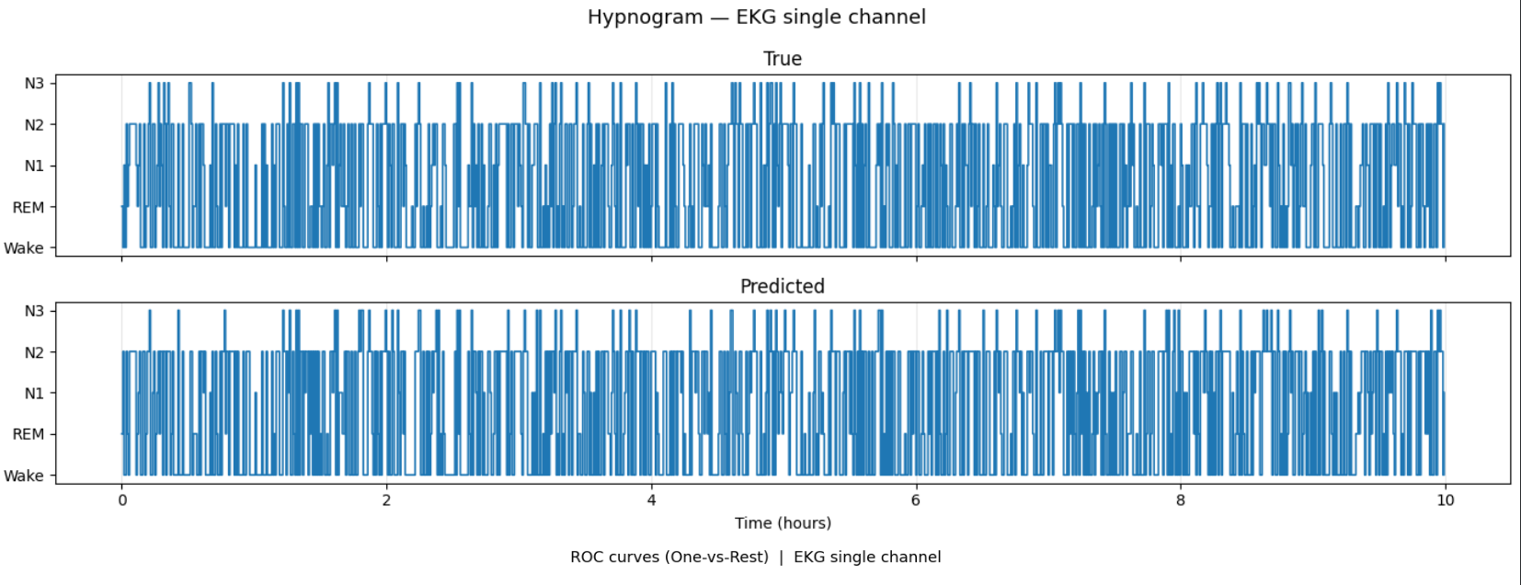
Confusion Matrix & Hypnogram Interpretation
Hypnogram: Side-by-side True vs Predicted sleep stages plotted over time (hours) — shows the model captures the overall sleep architecture despite some N1/REM confusion

Slide 20
ROC Curves & AUC Analysis
One-vs-Rest ROC: each class treated as positive vs all others. Computed separately for Train, Validation, and Test sets to check for overfitting.
Expected AUC Scores by Stage & Split
Stage
Train AUC
Validation AUC
Test AUC
Interpretation
Wake
~0.97
~0.95
~0.94
Excellent — very distinct from all other stages
N1
~0.88
~0.82
~0.80
Lowest AUC — hard to separate from N2/Wake
N2
~0.96
~0.95
~0.94
Strong — majority class with clear patterns
N3
~0.97
~0.96
~0.95
Excellent — deep sleep has distinct low-HR signature
REM
~0.93
~0.91
~0.90
Good — slight Wake overlap but context helps
Split: 85% Train | 15% Val & Test — stratified by class to ensure balanced representation in each set

Slide 21
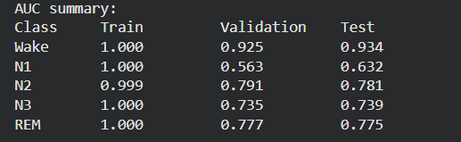
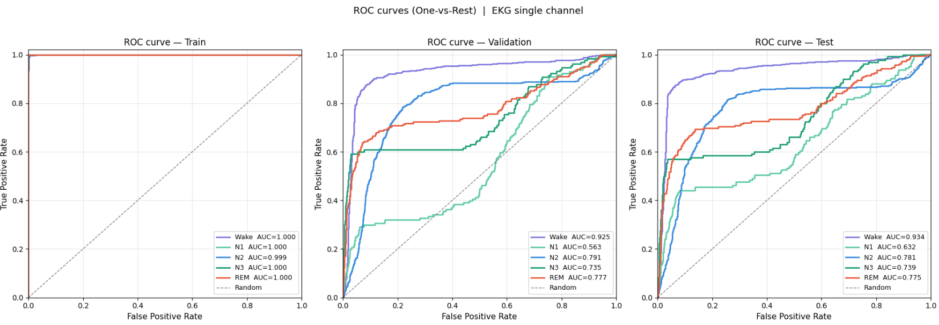
ROC Curves & AUC Analysis
One-vs-Rest ROC: each class treated as positive vs all others. Computed separately for Train, Validation, and Test sets to check for overfitting.
Interpretation

Slide 22
Engineering Challenges & Solutions
⚠ Memory Management (OOM Errors)
→ Processed spectral features in batches using numpy memmap — never loads full dataset into RAM
Impact: Essential for running on free Colab (~12GB RAM) with large EDF datasets
⚠ Severe Class Imbalance (N1 = 5%)
→ Multi-strategy oversampling: ECG augmentation + Mixup for N1; augmentation only for N3/REM; focal loss γ=2.5
Impact: Without this, model would achieve 80%+ accuracy by ignoring N1 entirely
⚠ EKG Channel Name Mismatch
→ Exact string match only ('EKG') — prevents accidental selection of EKG_Off, EKG2, EKG_ref variants
Impact: Different EDF files may have different channel naming conventions
⚠ REM vs Wake Ambiguity
→ Sequence context (9 epochs window) + HRV spectral features + boosted REM weight (×2.5)
Impact: Both stages have similar HR variability; temporal context disambiguates

Slide 23
Summary & Conclusions
End-to-End Pipeline
Single-Channel ECG
Complete sleep staging system: raw EDF → labeled epochs → features → model → evaluation, all in reproducible Colab cells
Demonstrated that ECG alone (without EEG/EOG/EMG) can classify 5-stage sleep with competitive accuracy via deep learning
Hybrid Architecture
Robust Training
Multi-scale CNN captures local ECG patterns; Transformer captures inter-epoch context; both are critical for REM detection
Focal loss + Mixup + heavy regularization handles the severe N1/N3/REM imbalance without overfitting on small MESA sample
Key Takeaway: A single ECG channel, combined with multi-scale deep learning and careful handling of class imbalance, can achieve clinically meaningful sleep staging — paving the way for low-cost wearable sleep monitoring.
Thank You • Questions?

